Slide 1
HIGH ENERGY COMPOUNDS
[High energy phosphate compounds]
Are substances which possess sufficient free energy to liberate at least 7.0 cal/mole at pH 7.0.
[When hydrolyzed liberate more energy than that of ATP]
CLASSIFICATION
 | Kcal/mole
PEP | – 14.8
Cabamoyl P | – 12.3
cAMP | – 12.0
1, 3 BPG | – 11.8
Creat – P | – 10.3
SAM | – 10.0
Acetyl Co A | – 7.7
ATP | – 7.3
 | Example
Pyrophosphate | ATP
Acyl phosphates | 1, 3-BPG
Enol phosphates | PEP
Thioesters | Acetyl CoA
Phosphoguanidine | Creatine-P

Slide 2
Redox couple: pair consisting of oxidant & reductant forms of an oxidizing or reducing agent. [Eg: NAD⁺/NADH, FMN/FMNH₂]
REDOX POTENTIAL
Is a quantitative measure of tendency of a redox pair to lose/ gain electrons under standard condition.
Intimately related to its free energy change.
∆F = - n. f. ∆E¹₀
F | Standard free energy
f | Faraday’s constant
n | no. of electrons
∆E¹₀ | Diff. bet^{n} redox potentials of couple
–ve redox pot.: low affinity for e⁻.
+ve redox pot.: high affinity for e⁻.
NaOH | Strong red. agent | -0.32V
O₂ | Strong oxidant | +0.82V

Slide 3
Formation of ATP:
Substrate Level Phosphorylation
Oxidative Phosphorylation
Adenylate Kinase Reactions
Consumption of ATP:
Early Stages of Nutrient Break Down
Interconversion of Nucleotide Tri Phosphates
Physiological Processes

Slide 4
MITOCHONDRIA
Electron microscopic studies revealed that mitochondria have two memb. systems:
Outer memb.
Inner memb.
Inner memb. is folded into a series of internal ridges called cristae.
Hence, there are 2 compartments in mitochondria:
Inter-membrane Space
Mitochondrial matrix
 | Takes place in
Oxidative phosphorylation | Inner mitochondrial memb.
Most rxns of TCA cycle & FA oxidation | Mitochondrial matrix

Slide 5
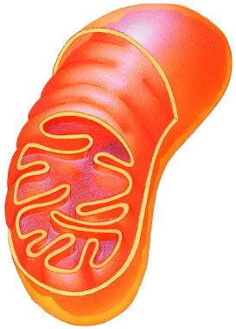
Mitochondria
Double membrane
outer membrane
inner membrane
highly folded cristae
enzymes & transport proteins
intermembrane space
fluid-filled space between membranes

Slide 6
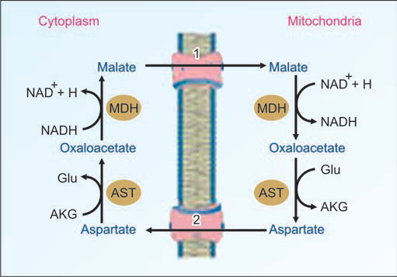

Slide 7
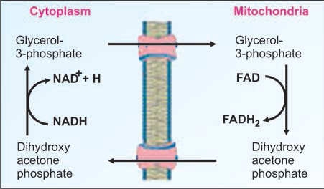

Slide 8
MECHANISM OF OXIDATIVE PHOSPHORYLATION
3 models have been proposed to explain ATP synthesis during transfer of electrons in ETC.
Chemical coupling
Conformational coupling
Chemiosmotic coupling

Slide 9
CHEMICAL COUPLING [Edward slater, 1953]
According to this hypothesis,
But this hypothesis lacks experimental evidience, as no such high energy intermediate has been found so far.
When electrons are transferred in ETC ↓ High energy intermediate formed. ↓ Hydrolysis of high energy intermediate ↓ Energy released is utilised for ATP synthesis

Slide 10
Conformational coupling [Paul Boyer in 1964]
Inner mitochondrial memb. Components exist in 2 conformational state.
There is some evidence demonstrating conformational changes in mitochondrial memb. proteins.
But no conclusive proof that such changes leads to ATP formation.
When electrons are transferred in ETC ↓ Confirmational changes in components ↓ High energy confirmation ↓ Back to low energy confirmation ↓ Energy released is utilised for ATP synthesis.

Slide 11
Chemiosmotic coupling
When electrons are transferred in ETC ↓ protons (H⁺) are pumped from matrix to outside of inner mitochondrial memb. ↓ Proton gradient generated across inner mitochondrial memb. ↓ Potential diff. across inner mitochondrial membrane ↓ Electrochemical gradient (low pH & more +ve outside & high pH & more -ve inside) drives mechanism resp. for ATP synthesis
F₀ subunit of ATP Synthase: pumps protons back into mitochondrial matrix with release of free energy
F₁ subunit of ATP Synthase: utilize free energy for ATP synthesis.

Slide 12
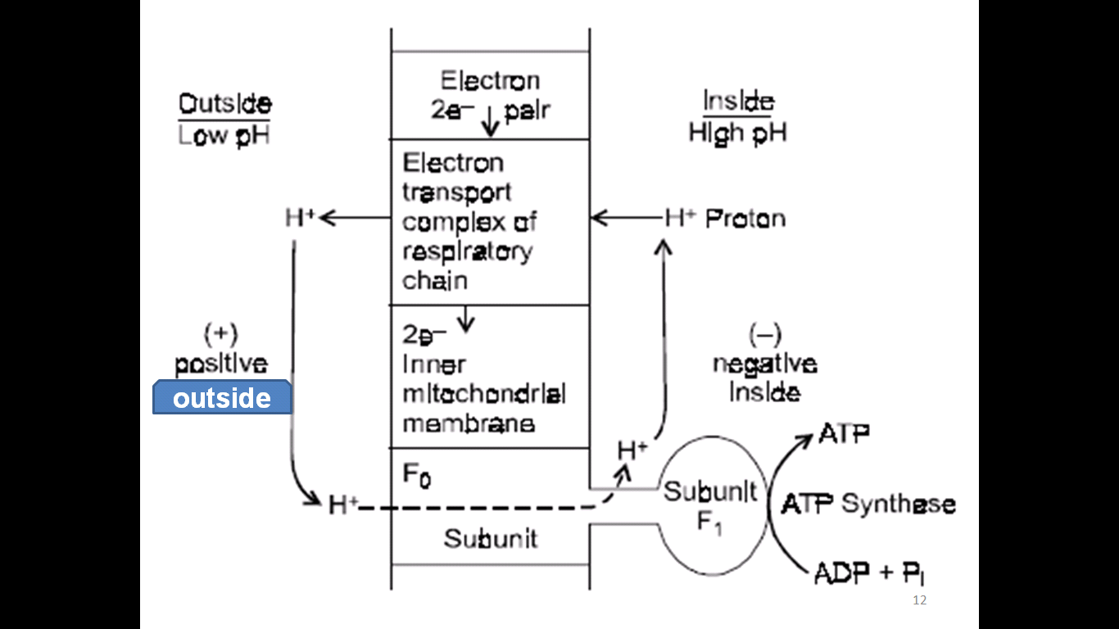
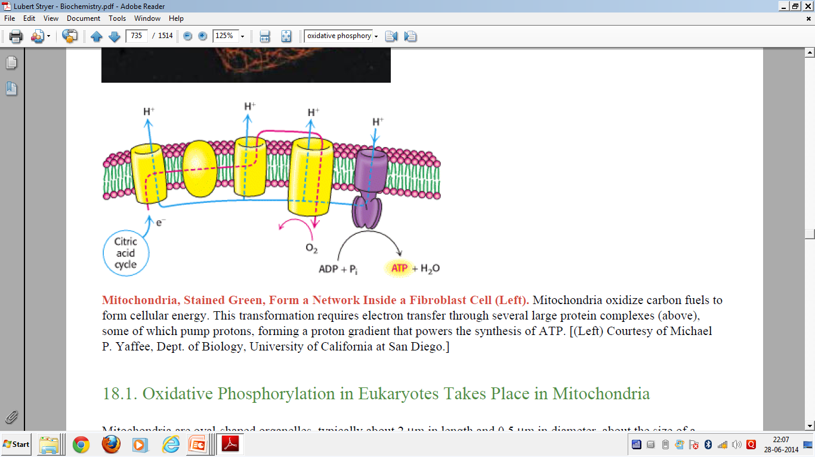
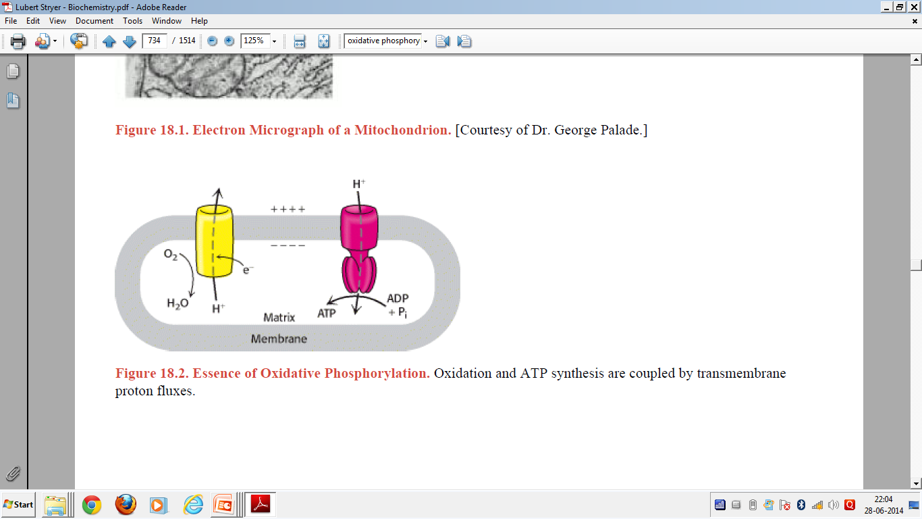

Slide 13
OXIDATIVE PHOSPHORYLATION

Slide 14
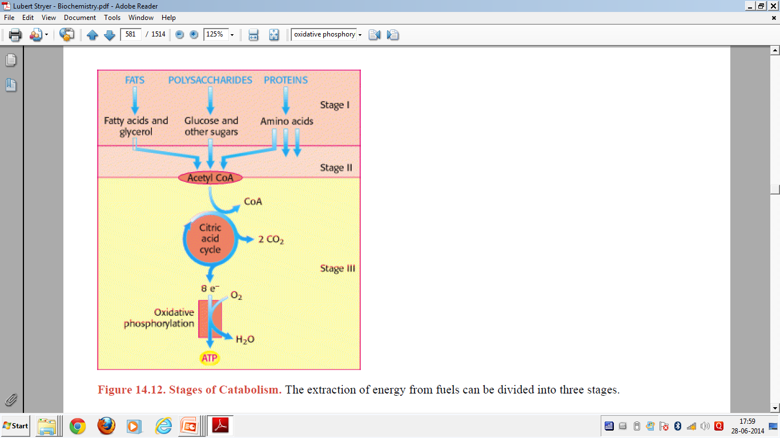

Slide 15
Oxidative phosphorylation:
Oxidation: Transfer of electrons from substrate to O₂
[oxidation of substrate]
Phosphorylation: ADP + Pi → ATP
2 processes coupled to each other.
Synthesis of ATP as a result of electron transfer in ETC is k/a oxidative phosphorylation.
Site: Mitochondria

Slide 16
Oxidative phosphorylation:
Major source of ATP in aerobic organisms.
Metabolic pathway [eg: TCA cycle] ↓ Yield electrons with high transfer potential ↓ Electron-motive force → proton-motive force ↓ Proton-motive force → Phosphoryl transfer potential.

Slide 17
Oxidative phosphorylation:
Flow of electrons in ETC
↓
electron-motive force generated
↓
Protons pumped out of mitochondrial matrix.
↓
Proton motive force is generated [pH gradient]
↓
Transmembrane electric potential.
↓
ATP synthesis occurs when protons flow back to mitochondrial matrix through an enzyme complex.

Slide 18
Mitochondrial ELECTRON TRANSPORT CHAIN (ETC) Respiratory Chain

Slide 19
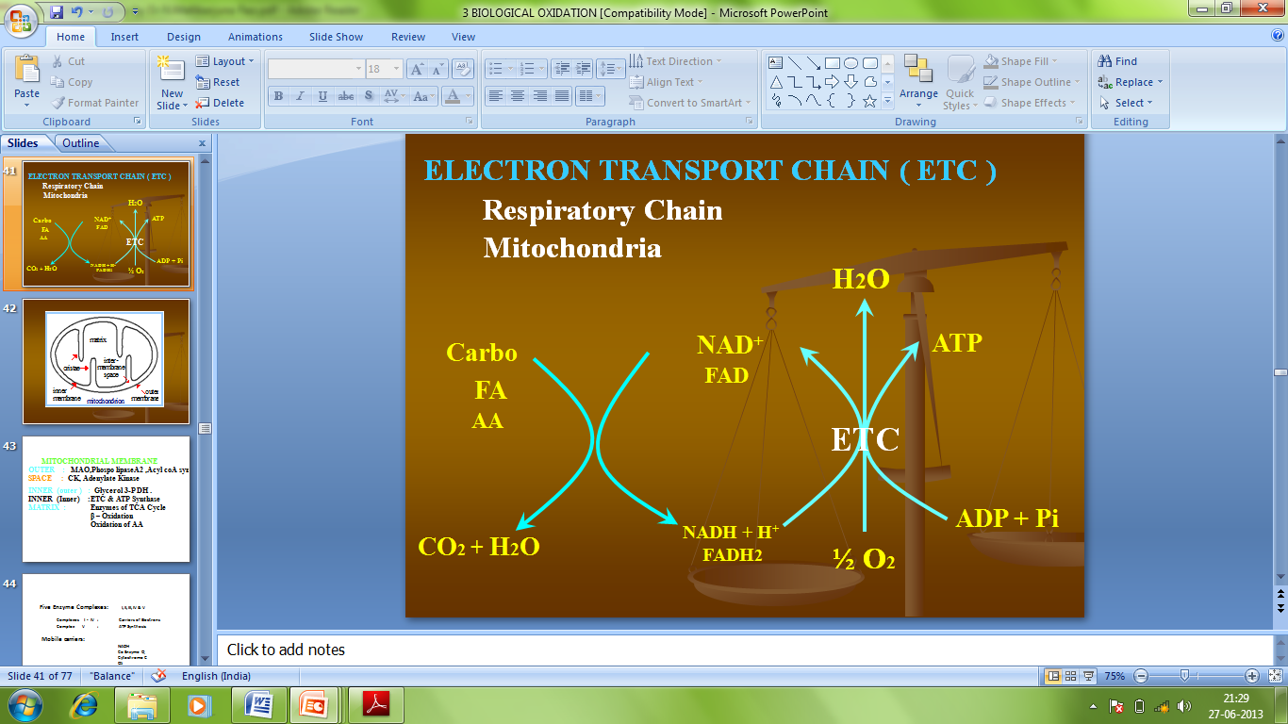
Reduction of molecular O₂ by NADH & FADH₂ occurs in a no. of electron transfer rxns, taking place in a set of memb. proteins known as electron-transport chain.
ETC: final common pathway in aerobic cells.

Slide 20
ETC: series of highly organised oxidation- reduction enzymes.
ETC consist of various components (proteins & non-protein)
inner mitochondrial membrane
transports electron.
arranged in order of ↑ing redox potential.

Slide 21
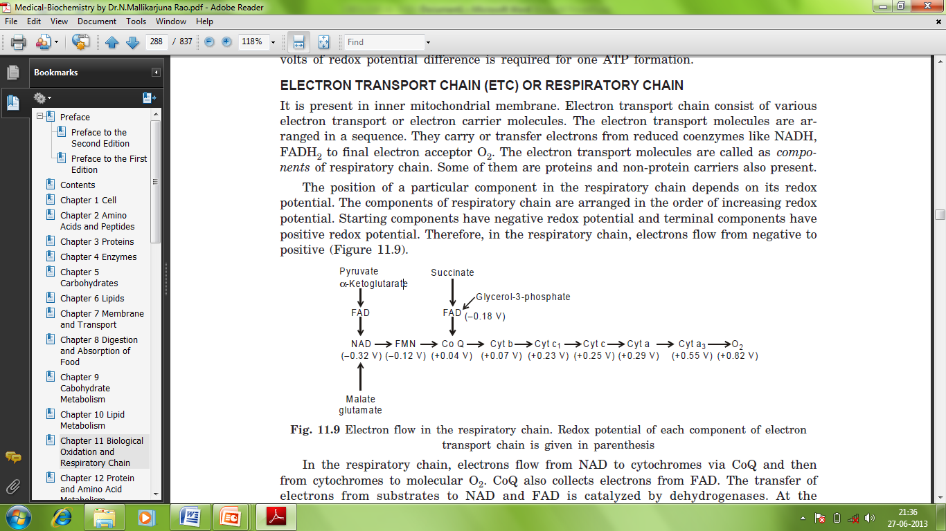
Components of ETC
Nicotinamide nucleotides
Flavoproteins
Fe-S proteins
CoQ
Cytochromes
Electron flow in ETC

Slide 22
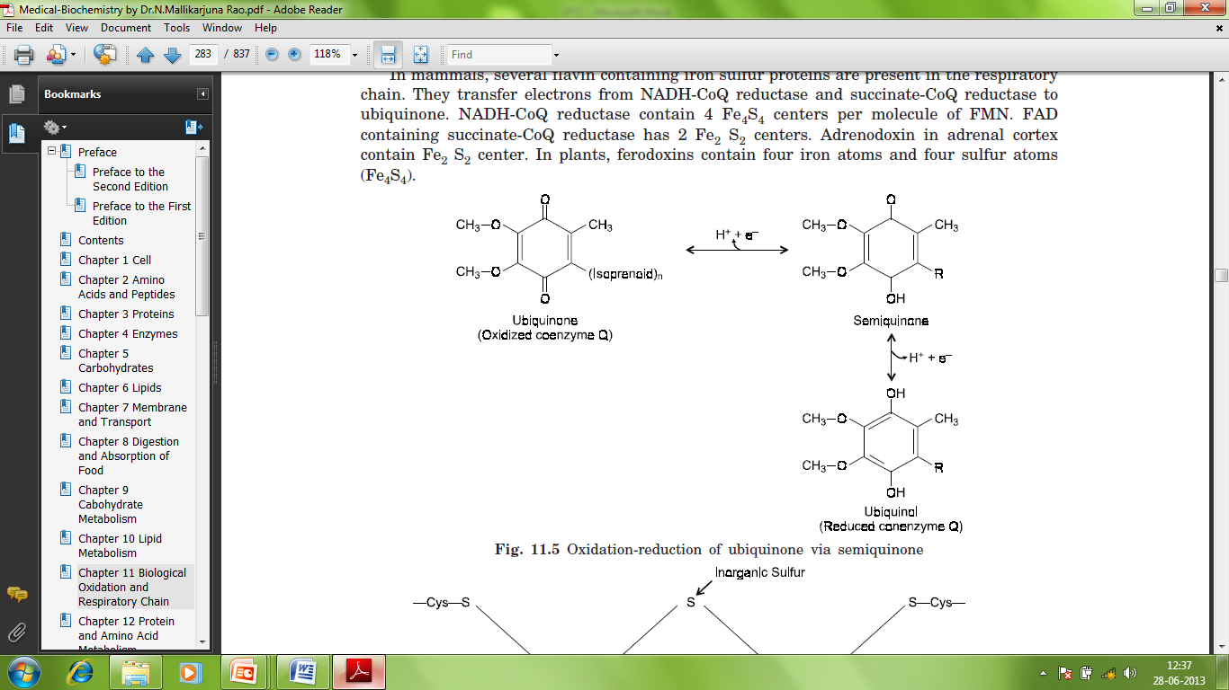
Ubiquinone or Coenzyme Q (CoQ)
Ubiquitous in nature & Quinone derivative
Only non-protein component of ETC.
It is a mobile, lipophilic electron carrier of ETC.
Collects electrons from FMNH₂ produced in ETC, NADH & FADH₂ produced outside ETC & transfers to cytochromes.

Slide 23
Cytochromes
Heme proteins.
Heme group differ from that of Hb (Fe²⁺) & Mb (Fe²⁺).
Iron oscillates between Fe²⁺ & Fe³⁺ states, & participates in oxidation-reduction rxns.
Involved in e⁻ transfer from ubiquinone to Cyt. oxidase.
Depending upon type of Respective absorption spectrum, cytochromes are of diff. types.
Cyt. a, b, c, c₁, b₁, b₂, a₃.
Electrons are transported from CoQ to cytochromes b, c₁, c, a, a₃.

Slide 24
ETC consists of 5 complexes.
Complexes I - IV: Carriers of Electrons
Complex V: ATP Synthesis

Slide 25
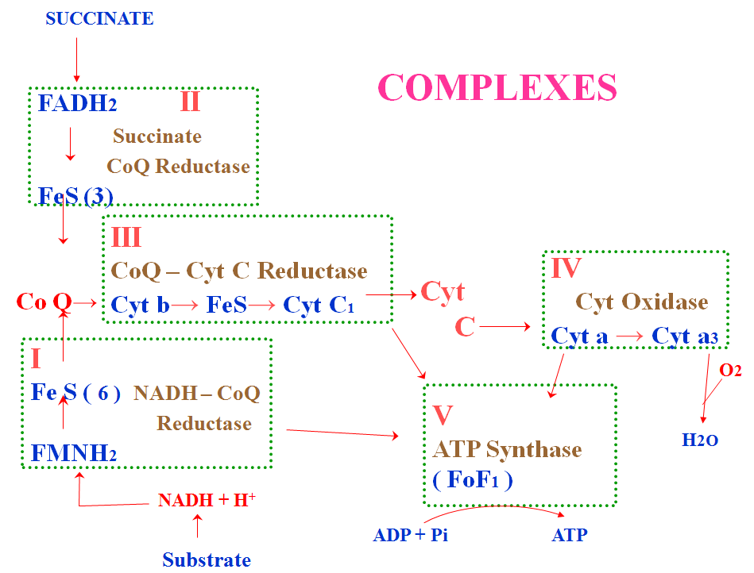

Slide 26
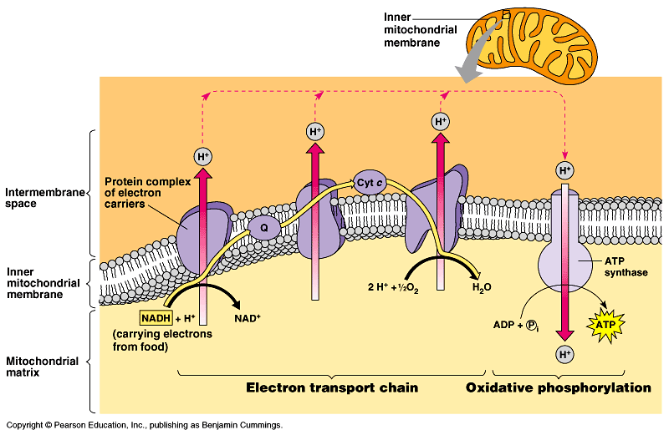

Slide 27
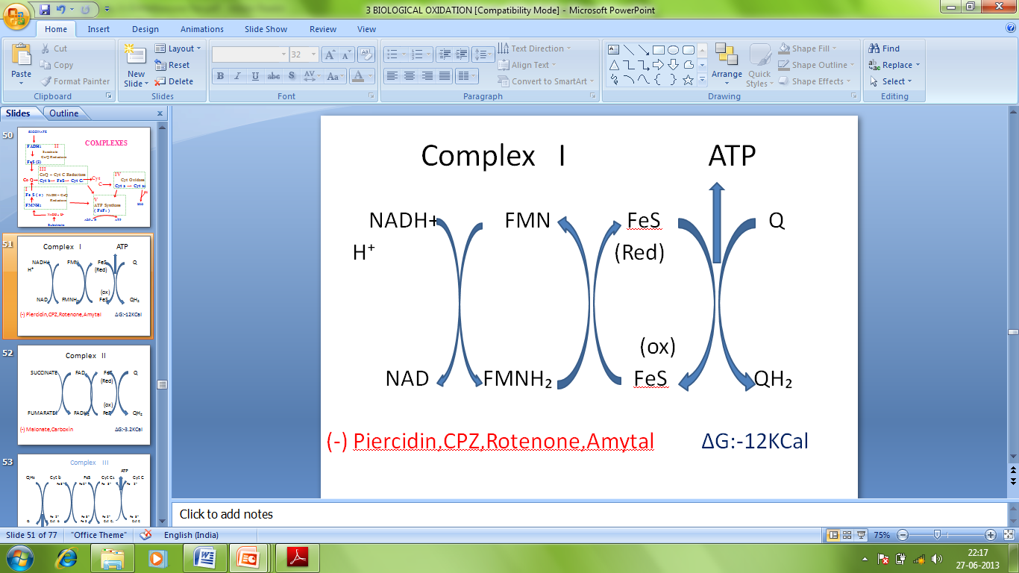
Complex I / (NADH CoQ Reductase) / (NADH dehydrogenase)
Redox potential = +0.420
Functions
Electron transferring
Acts as a proton pump
Prosthetic groups: FMN & Fe:S clusters.

Slide 28
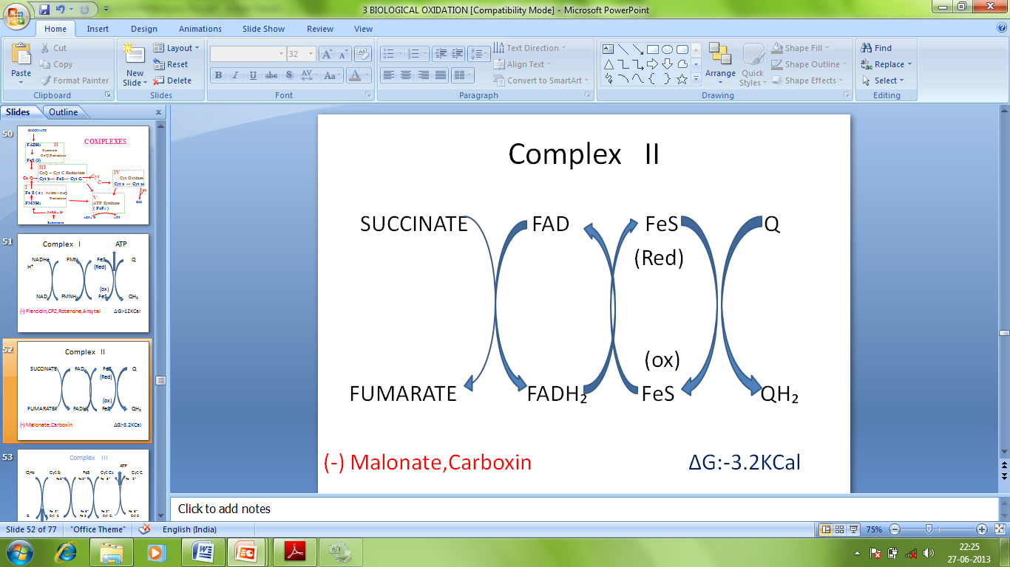
Complex II (Succinate- CoQ Reductase)
Small energy doesn’t allow system to pump protons across mitochondrial membrane, hence no ATP formation.
Functions
Electron transferring
Prosthetic groups: FAD

Slide 29
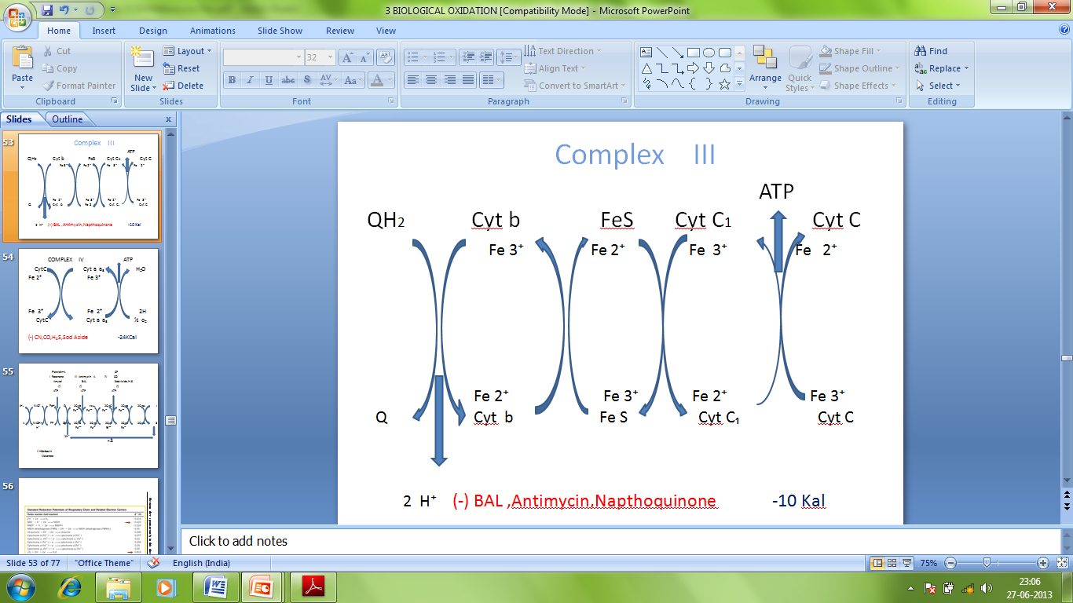
Complex III (CoQ- Cyt. C Reductase)
Functions
Acts as a proton pump.
Transfer of electrons.

Slide 30
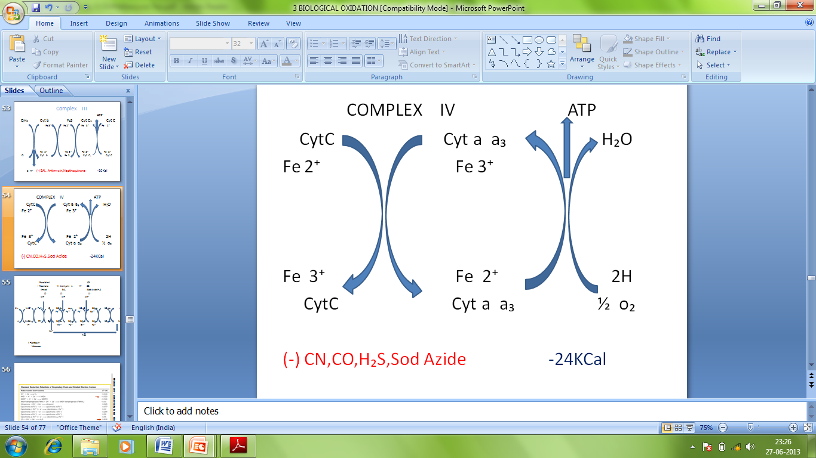
Complex IV (Cyt. C Oxidase)
Terminal component of ETC.
Functions
Acts as proton pump.
Catalyzes transfer of electrons to molecular O₂ to form H₂O

Slide 31
Complex V (ATP Synthetase)
Site of oxidative phosphorylation
Catalysed by ATP synthase [F₀ F₁ ATPase].
Integral memb. protein of inner mitocondrial memb.
Present in knob-like structure present on cristae of inner mitochondrial membrane.

Slide 32
Complex V (ATP Synthetase)
[ATP synthase/ mitochondrial ATPase/ H⁺ ATPase]
large enzyme complex [mol. wt. =5,20,000 Kda]
Consists of two subunits:-
F₁ subunits [Head of knob] [α₃ β₃ γ₁ δ₁ ε₁]
Made up of five polypeptide chains.
have catalytic activity.
F₀ subunits [Base of knob] [α₁ β₂ c₁₂]
Embedded in membrane.
Twelve c & α subunit forms ion Channel for H⁺.
Free energy released during translocation of H⁺ (via F₀ subunit) is utilized by F₁ subunit for ATP synthesis.

Slide 33
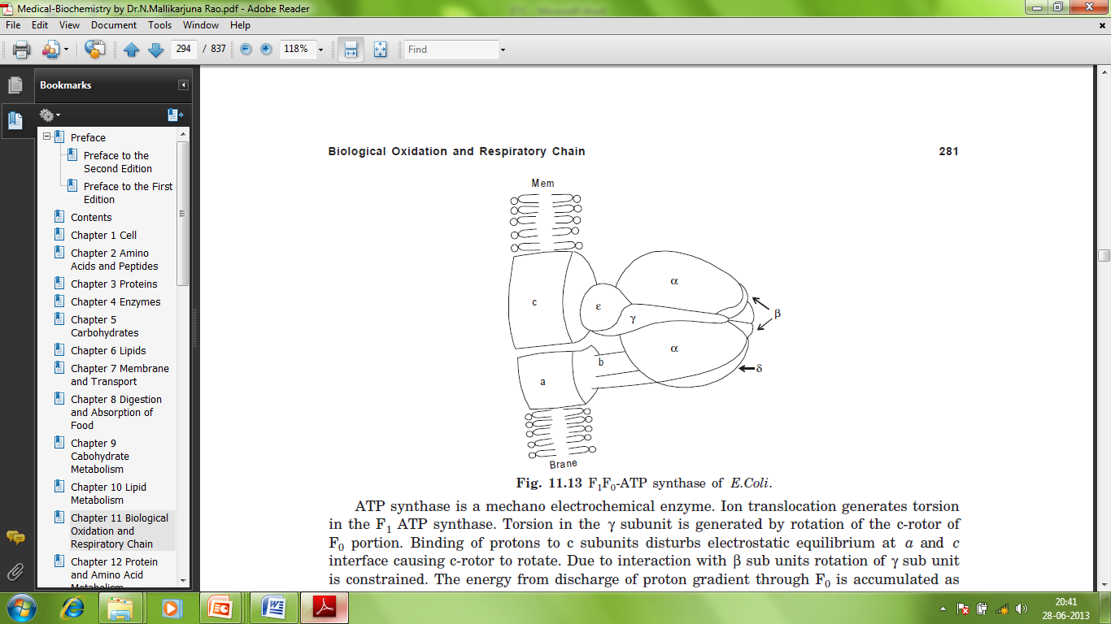

Slide 35
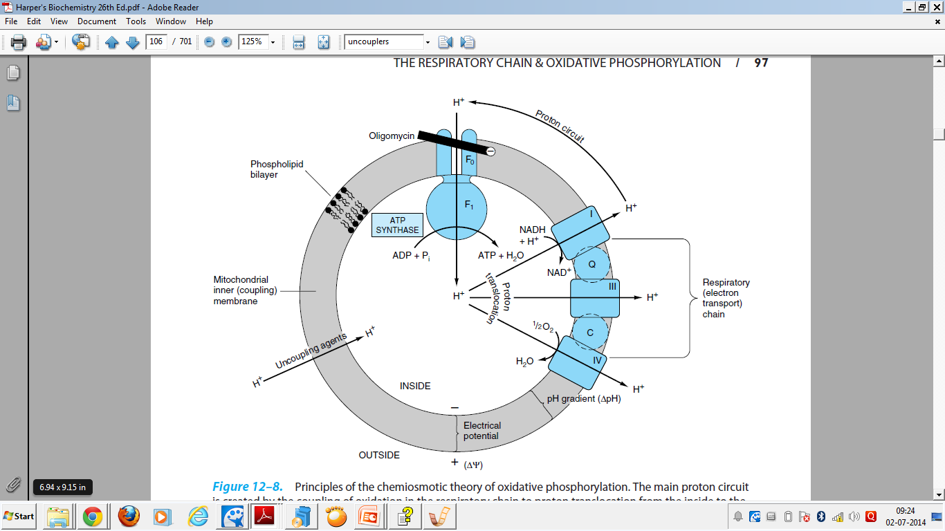

Slide 36
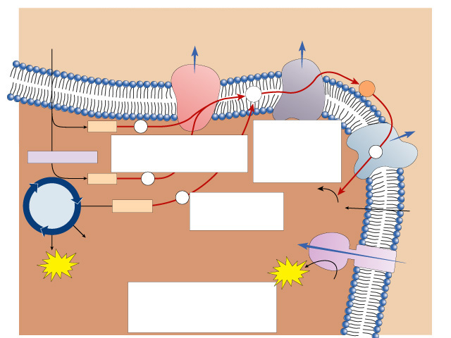
Pyruvate from
cytoplasm
Inner
mitochondrial
membrane
Intermembrane
space
H⁺
H⁺
Electron
transport
system
Q
C
NADH
e⁻
2. Electrons provide energy to pump protons across the membrane.
H⁺
1. Electrons are harvested and carried to the transport system.
e⁻
Acetyl-CoA
NADH
e⁻
H₂O
Krebs
cycle
e⁻
3. Oxygen joins with protons to form water.
1
FADH₂
2
O₂
O₂
+
2H⁺
CO₂
H⁺
ATP
ATP
H⁺
ATP
4. Protons diffuse back in down their concentration gradient, driving the synthesis of ATP.
ATP
synthase
Mitochondrial
matrix

Slide 37
Free Energy changes & site of ATP production
Step | Diff. in Redox Potential | Free energy changes (Kcal)
NAD⁺----> FP | +0.26V | -12.004
FP----> Cyt.b | +0.1V | -4.617
Cyt.b----> Cyt.C₁ | +0.23V | -10.619
Cyt.C₁---->Cyt.a₁ | -0.03V | -0.923
Cyt.a₁---->Cyt.a₃ | +0.21V | -9.695
Cyt.a₃---->O₂ | +0.32V | -14.774
TOTAL | +1.14V | 52.63
At three sites, free energy released per electron pair transferred is sufficient to support phosphorylation of ADP to ATP.

Slide 38
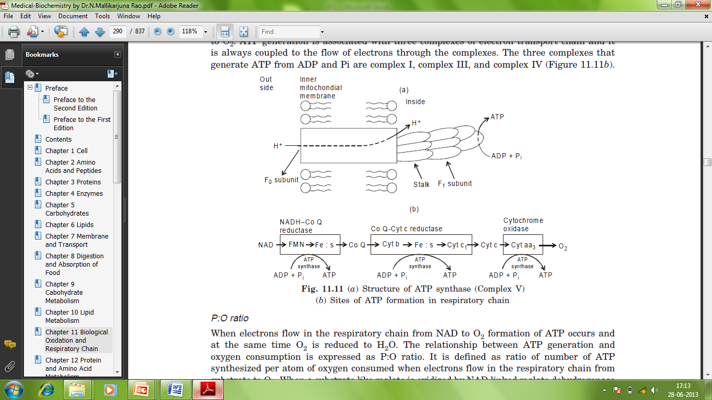
SITES OF PHOSPHORYLATION [ATP Synthesis]
ATP synthesis in ETC requires a redox potential diff. of ~ 0.15V thus ATP synthesis takes place only at specific points.
Complex I, complex III, & complex IV generate ATP.

Slide 39
P : O ratio
Ratio of no. of ATP synthesized per atom of oxygen consumed when electrons flow in ETC from substrate to O₂.
Oxidation of NADH in ETC is accompanied by formation of 3 ATP molecules & one oxygen atom is reduced to water, thus P: O ratio is 3.
Oxidation of FAD generates 2 ATP molecules per atom of oxygen consumed, i.e., P: O ratio is 2.

Slide 40
INHIBITORS OF RESPIRATORY CHAIN
Several drugs, poisons & toxins block oxidative phosphorylation or ATP synthesis or flow of electrons in ETC.
They act mainly at the sites of ATP synthesis.
Inhibitors of complex I
Amytal (barbiturate) | Inhibit NADH-CoQ reductase Used as sedative
Rotenone | used as insecticide, non-toxic to humans blocks electron transfer from FeS clusters
Piericidin | Used as antibiotic
Alkylguanides

Slide 41
Inhibitors of complex II
Carboxin | Succinate → CoQ
Malonate | Succinate → Fumerate
X
X
Inhibitors of complex III
Antimycin A | Inhibits cytochrome reductase Used as antibiotic
BAL (British anti lewisite) | Inhibits cytochrome reductase Used as therapeutic agent in arsenic poisoning.

Slide 42
Inhibitors of complex IV
Cyanide (CN) | Inhibit cytochrome oxidase by binding cytochrome a₃.
Carbon monoxide (CO) | Inhibit Cyt. Oxidase
Hydrogen sulfide (H₂S) | Inhibit Cyt. Oxidase
Azide | Inhibit Cyt. Oxidase
Other inhibitors of oxidative phosphorylation
Atractyloside
Inhibit F0 subunit
Oligomycin
Inhibit F0 subunit
Rutamycin
It blocks phosphorylation without uncoupling.

Slide 43
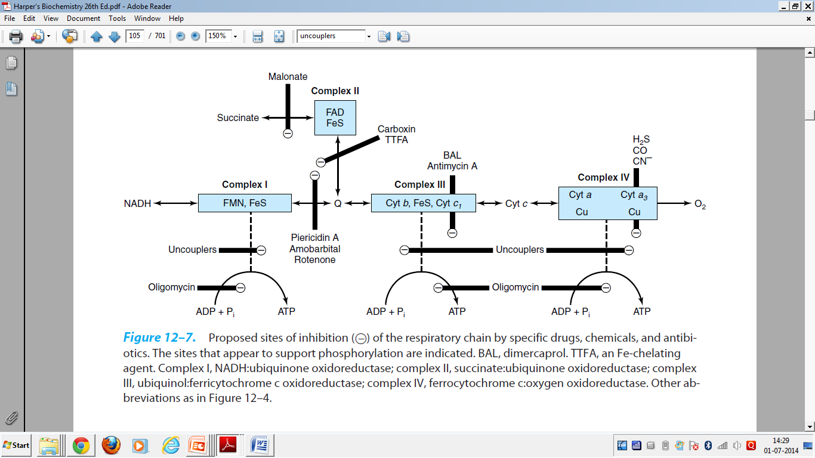

Slide 44
UNCOUPLERS
Agent that inhibits ATP synthesis by dissociating or uncoupling oxidation from phosphorylation at one/ more of the phosphorylation site.
So, oxidation takes place without ATP synthesis.
Example
Thermogenin: converts free energy released during proton translocation to heat energy.
2,4-DNP (proton ionophore): shuttle protons across membranes, defeats proton gradient collapsing proton motive force .

Slide 45
UNCOUPLERS
Valinomycin
Transports K⁺ from cytosol into matrix in exchange of H⁺, defeats both proton gradient and electrical gradient.
Oligomycin:
Closes F₀ subunit
Ethanol, salicylic acid
Deplete ATP
& ↑ body temp. if taken in excess
Calcium
Ca enters mitochondria by active transport (ATP consumed), binds Pi.

Slide 46
UNCOUPLERS
Dicoumarol (Vit. K analogue)
Chloro carbonyl cyanide phenyl hydrazone
Physiological uncouplers
↑ T₄
Long chain FA in brown adipose tissue
Unconjugated hypobillirubinemia

